Slide 1


InsurAI
Intelligent insurance management system
presented by :
SANCHITA KUMARI
Intern at Infosys Springboard

Slide 2

Project Overview
InsurAI is a full stack web application designed to streamline and simplify insurance management.
Core Function: It provides a unified digital platform connecting:
Insurance Agents
Policyholders (Users)
Admins
Primary Goal: To digitalize and manage policy tracking, approval workflows,and essential communication in a single, efficient system.

Slide 3
Problem statement
  Traditional insurance management is manual and time-consuming
  Agents struggle to manage clients efficiently.
  Policyholders face delays in approvals and updates. Admins lack a centralized system for monitoring.

Slide 4
Working of InsurAI
  User Registration & Login
Users and agents can register with role-based access.
  Dashboard
Admin
  Fetch user data and appointments
  Manage policies
  Approve /reject agents
Agents
  Fetch user data and appointments
  Approve or reject appoitments

Slide 5
User
  Fetch Policies
  Buy policies
  Schedule appointments
  Policy Management
Admin can perform CRUD operations on the policies.
  Approval Workflow
Admin approves/rejects user requests.
  Notification system
A real time notification system is enabled for users and agents
  AI chat system
AI chat system with voice recognition is implemeted in the project

Slide 6
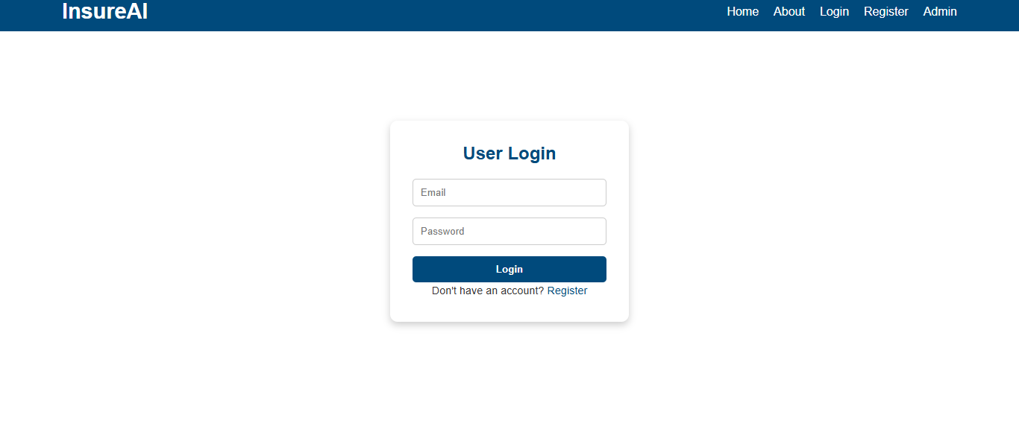
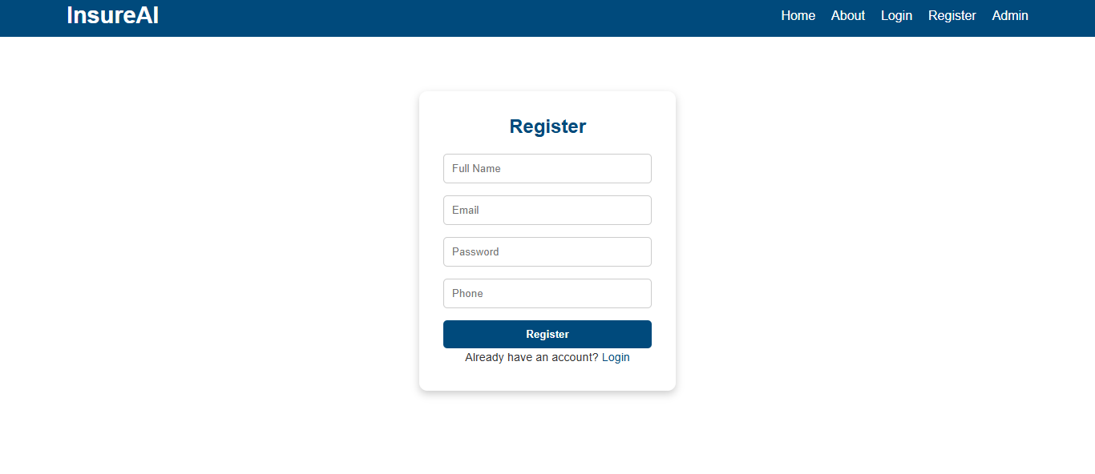

Slide 7
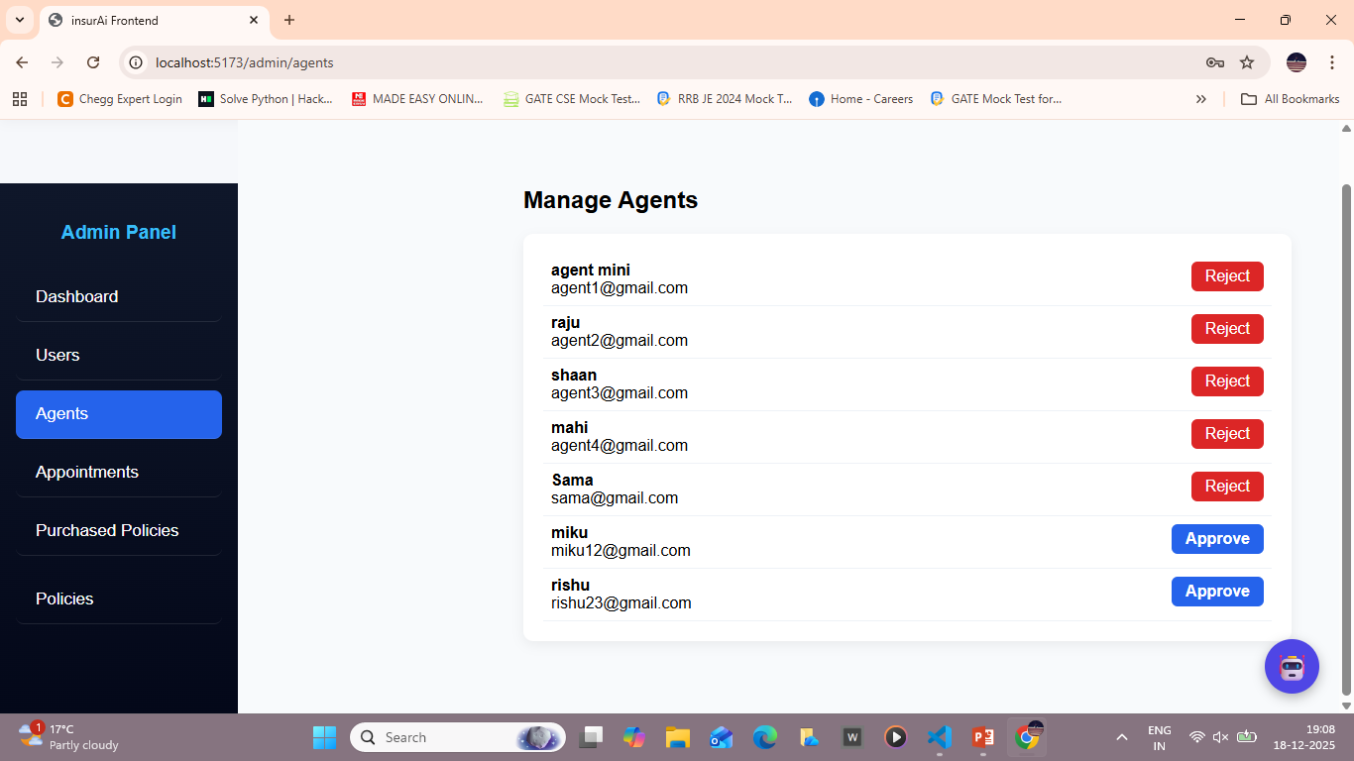
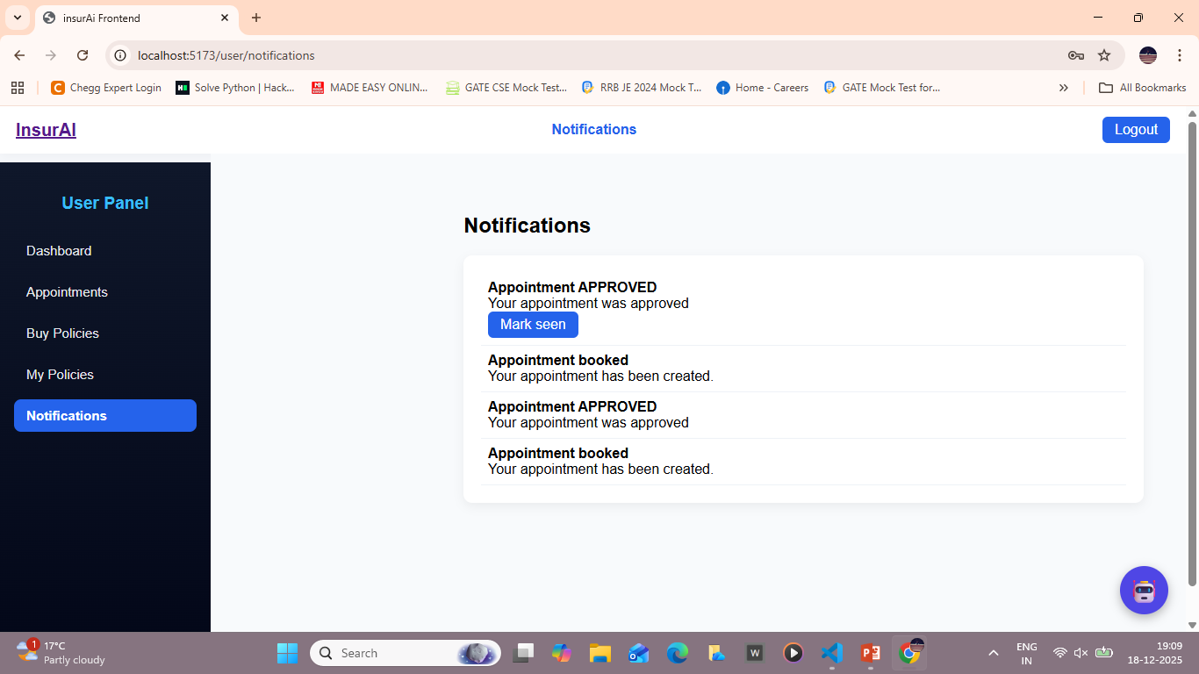

Slide 8
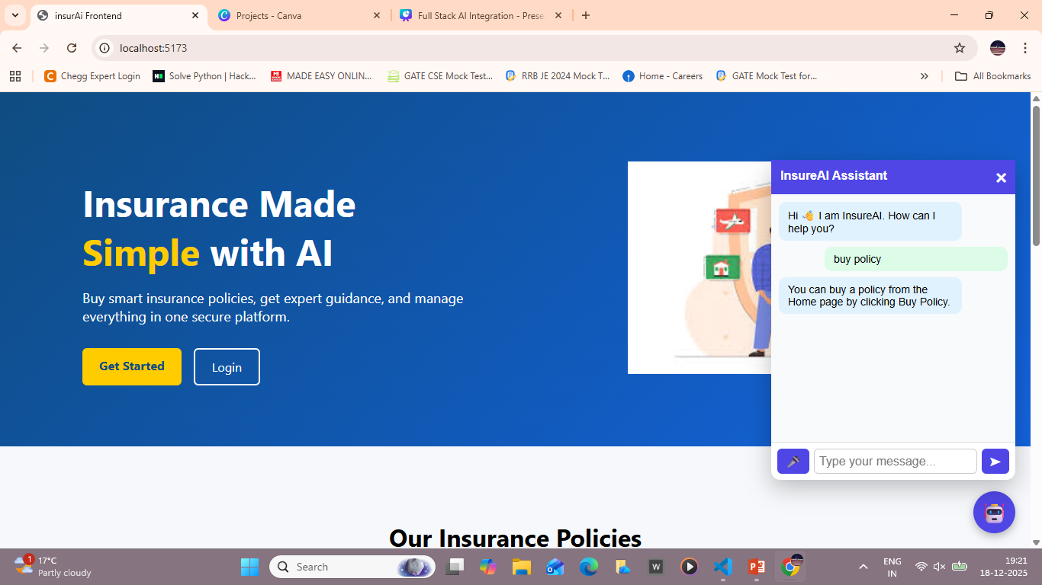
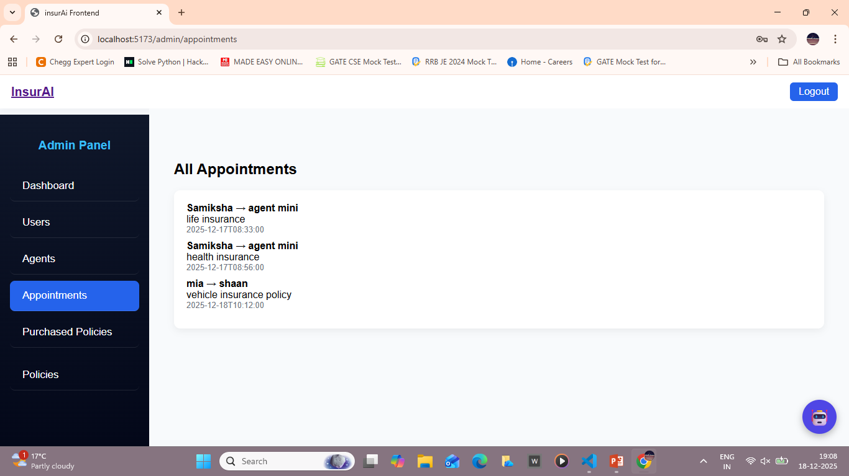

Slide 9

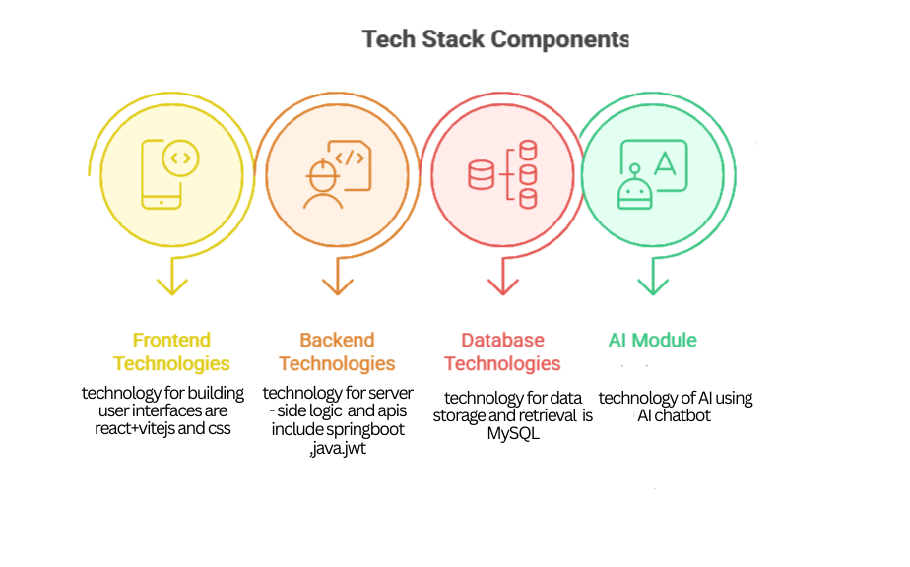
Technology stack
  Frontend: React (Vite)+CSS
  Backend: Spring Boot (Java)
  Database: MySQL
  API: RESTful endpoints
  Security: Role-based access
control

Slide 10
Features
  Role-based dashboards (Admin, Agent, User)
  Real-time policy tracking
  Simplified agent-client communication
  Admin control over approvals and reporting
  User-friendly interface
  voice query system
  Appointment Scheduling

Slide 11


Future Scope
Integration with payment gateways for online premium payments
Mobile app development for on-the-go access
Al-driven policy recommendations for users
Analytics dashboard for agents and admins
Expansion to insurance claim management

Slide 12
Conclusion
  Insurai bridges the gap between agents and policyholders.
  Enhances efficiency, transparency, and user experience.
  Future improvements can make it a complete digital insurance ecosystem.

Slide 13
Thanking you

